Slide 1

PhonePe Analysis Report
1. Business Requirements:
Transaction Performance Monitoring: Analyse overall transaction volume and transaction
value to evaluate business performance and monitor growth trends over time.
2. Transaction Success Rate Analysis: Monitor the percentage of successful transactions to
assess payment reliability, identify potential transaction issues, and improve customer experience.
3. Customer Demographic Analysis: Evaluate transaction contributions across different age
segments to understand customer behaviour and identify key user demographics.
4. Service-Wise Transaction Analysis: Analyse transaction values across different PhonePe
services to identify the most utilized services and understand customer preferences.
5. User Engagement and Usage Pattern Analysis: Identify top-performing users and compare
weekday versus weekend transaction activity to understand usage patterns and support
targeted customer engagement strategies.

Slide 2
PhonePe Analysis Report
2. Steps in Analysis :
1. Imported the dataset in Power BI.
2. Checked all the columns headers.
3. checked all columns Data types.
4. Checked for Null values in all the columns.
5. In the service column, replacing the '_' sign with ' '.
6. A New table, "Date_Table" is created using DAX.
7. In All_User table Column "User_ID" must contains Non-Null and Non-Duplicate values.
So, Removed blank rows and Duplicate rows.
8. In Model view, "User_ID" from both tables i.e. "All_Users" and "All_Transactions" are mapped,
with Cardinality "One-to-Many.
9. Column "Date" from both tables i.e. "Date_Table" and "All_Transactions" are mapped,
with Cardinality "One_to-Many".
10. Before Visualization, we created some important Measure (KPIs).
11. All the derived measures are kept in separate table named "Measures" So that we don't need to find them each time.
12. Created a column "Age Segment" in All_users table.
13. Started Visualisation.

Slide 3
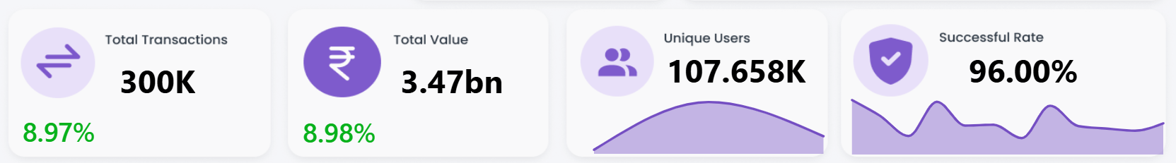
PhonePe Analysis Report
3. Visualisation :
3.1 KPIs:
Insights:
Overall Total Number of Transaction : 300,000.
Total Transaction Value : 3.47 Billion.
Total Unique Users : 107,658
Succes Rate : 96 %

Slide 4
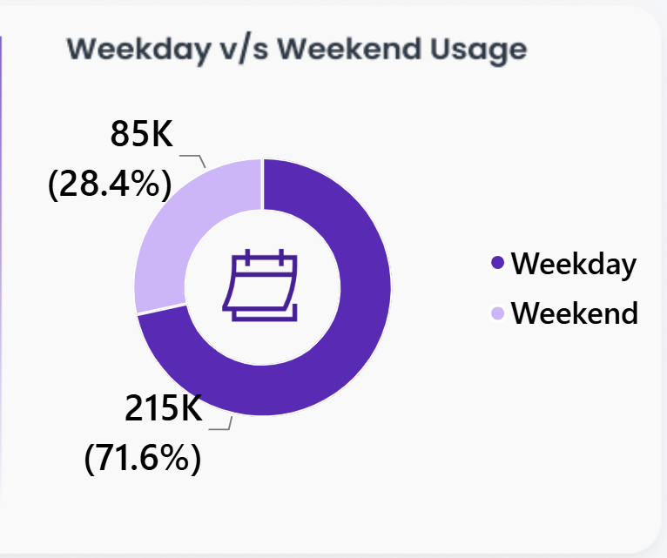
PhonePe Analysis Report
3.2 : Weekdays Vs Weekend Usage
Insight:
Weekday Usage : 28.4 %
Weekend Usage : 71.6 %

Slide 5
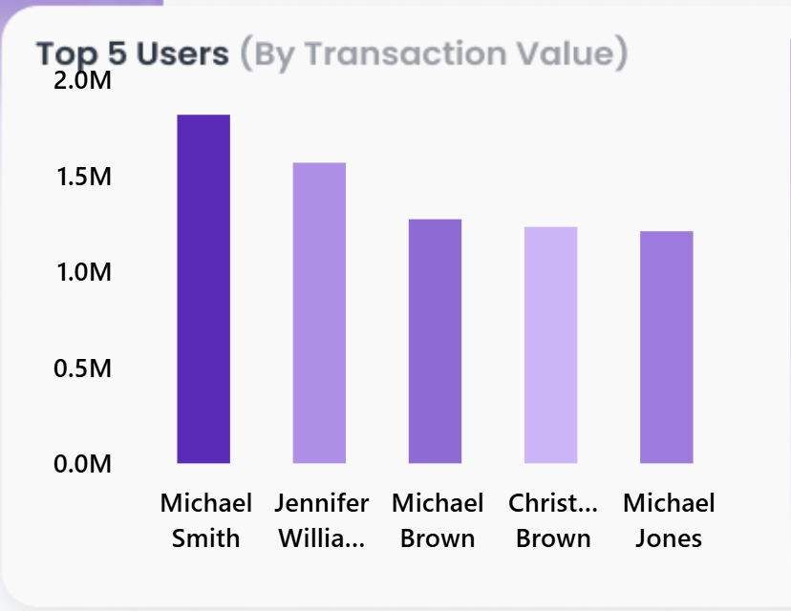
PhonePe Analysis Report
3.3 : Top 5 Users (By Transaction Value)
Insight:
Michael Smith with over 1.5 Million value at top.
Jennifer Williams at second place.
Michael Brown , Christopher Brown and Michael jones are next.

Slide 6
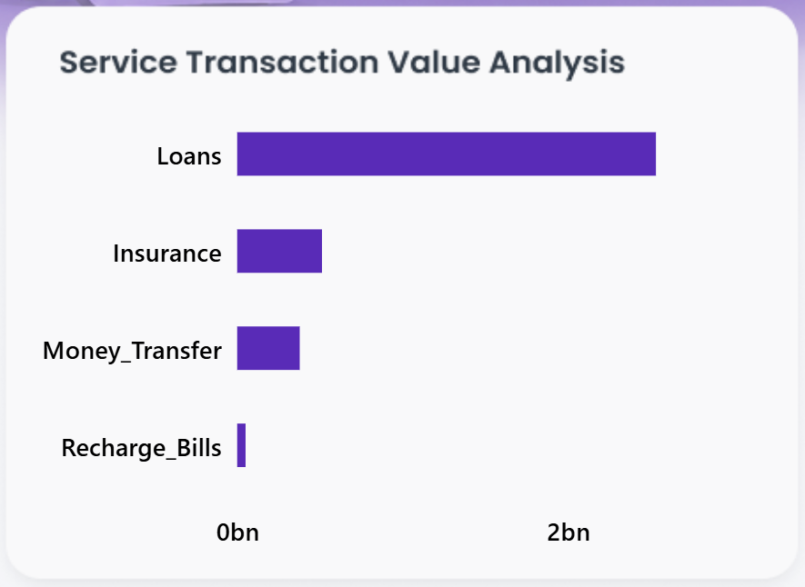
PhonePe Analysis Report
3.4 : Service Transaction Value Analysis
Insight:
Loan Service is at Top with over 2 Billions Transaction Value.
Insurance and Money Transfer comes at 2nd and 3rd place.
Recharge Bills has Least Transaction Value.

Slide 7
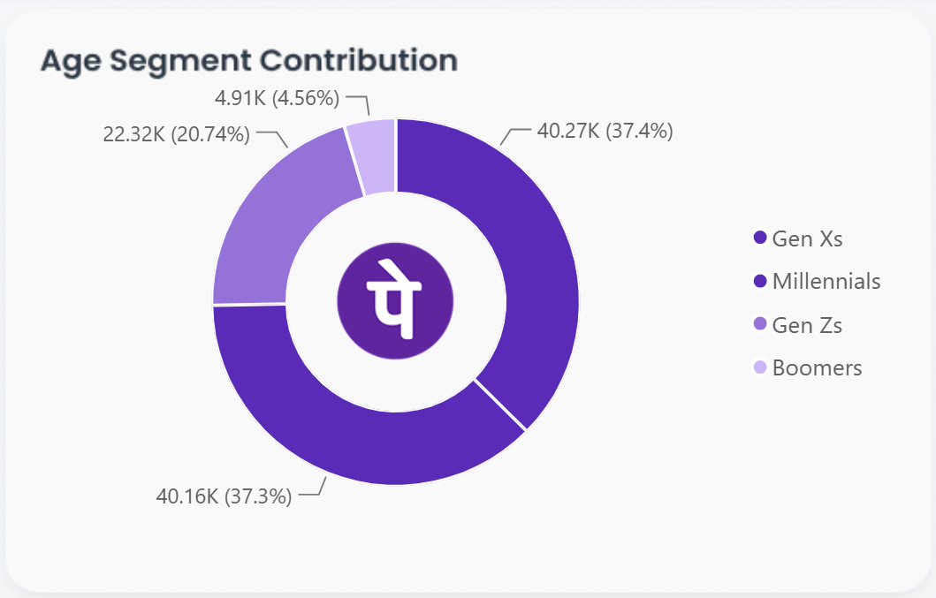
PhonePe Analysis Report
3.5 : Age Segment Contribution:
Insight:
The Age segment Gen-X’s are having more Usage than others.
Millennials And Gen-Z’s comes at 2nd and 3rd place in Usage.
Boomers are having least usage.

Slide 8
PhonePe Analysis Report
4. Business Recommendations :
Focus more on Age segments Gen-Z and Boomers. Provide more offers to attract them.
Encourage the users by Organising campaigns for Insurance Services.
Provide attractive offers on Recharge Bills payments.
Bestow higher-value incentives to recognize and retain our most loyal cohorts.

Slide 9
PhonePe Analysis Report
QnA

Slide 10
PhonePe Analysis Report
THANK
YOU…!!!

